Slide 1
Single Cell Sequence Analysis:
A brief introduction

Slide 2
Plan
Brief description of the technology
What are the differences compared to bulk analysis
Potential
Increased data complexity
Typical analysis
QC
Clustering
Cluster-cell type identification
DE, differentiation trajectories, cell type proportions, cell signaling

Slide 3
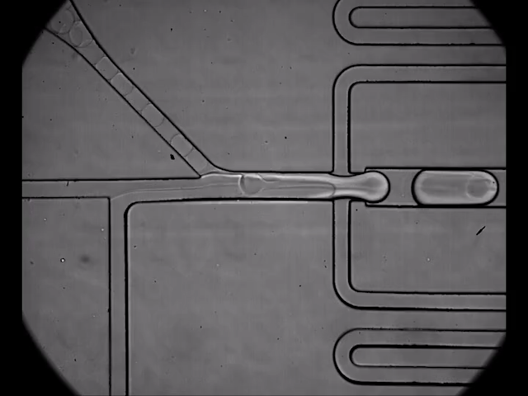
Microfluidics approach

Slide 4
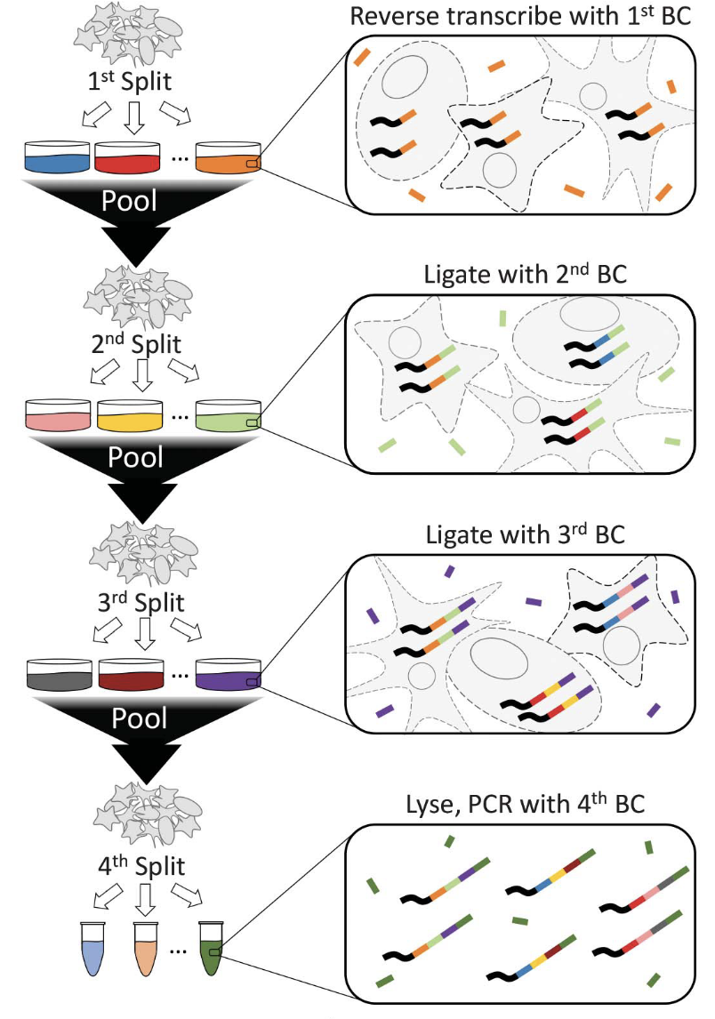
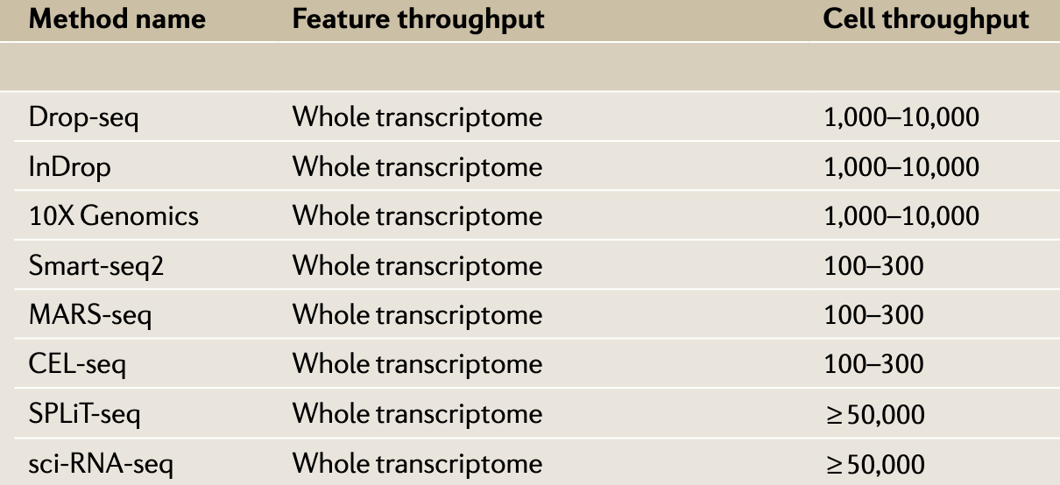
Technologies to obtain s.c. (RNA) sequence data
SPLiT-seq
microfluidics
1,000-20,000
*
Split & pool
*
Parse Biosciences
Stuart & Satija; NRG 2019
* Commercially available 10x & Parse Biosciences
Rosenberg et al; science 2018

Slide 5
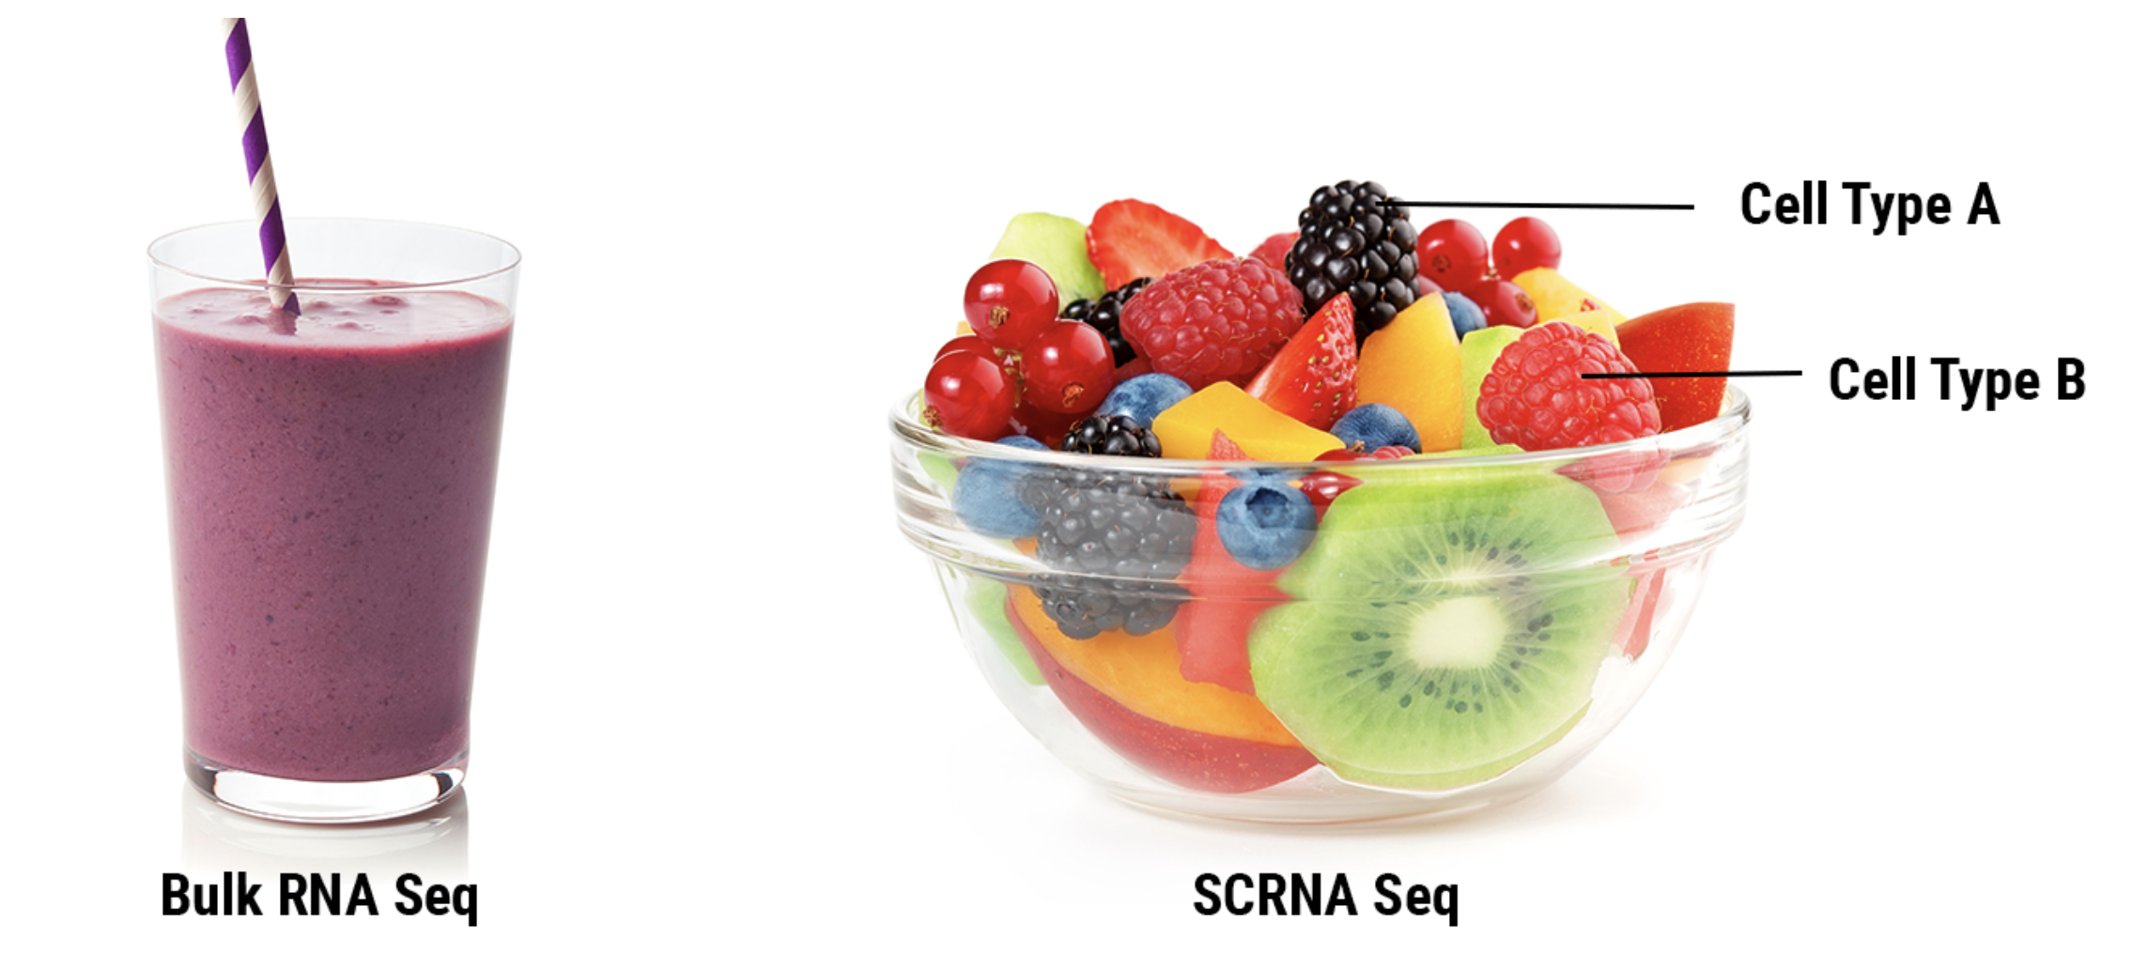
Idiosyncrasies of s.c. data
 | Sample | Sample | Sample | ….
Gene1 | Read counts | … | … | …
Gene1 | …
Gene1 | …
 | Bc_sample | Bc_sample | Bc_sample | ….
Gene1 | UMIs | …
Gene1 | …
Gene1

Slide 6
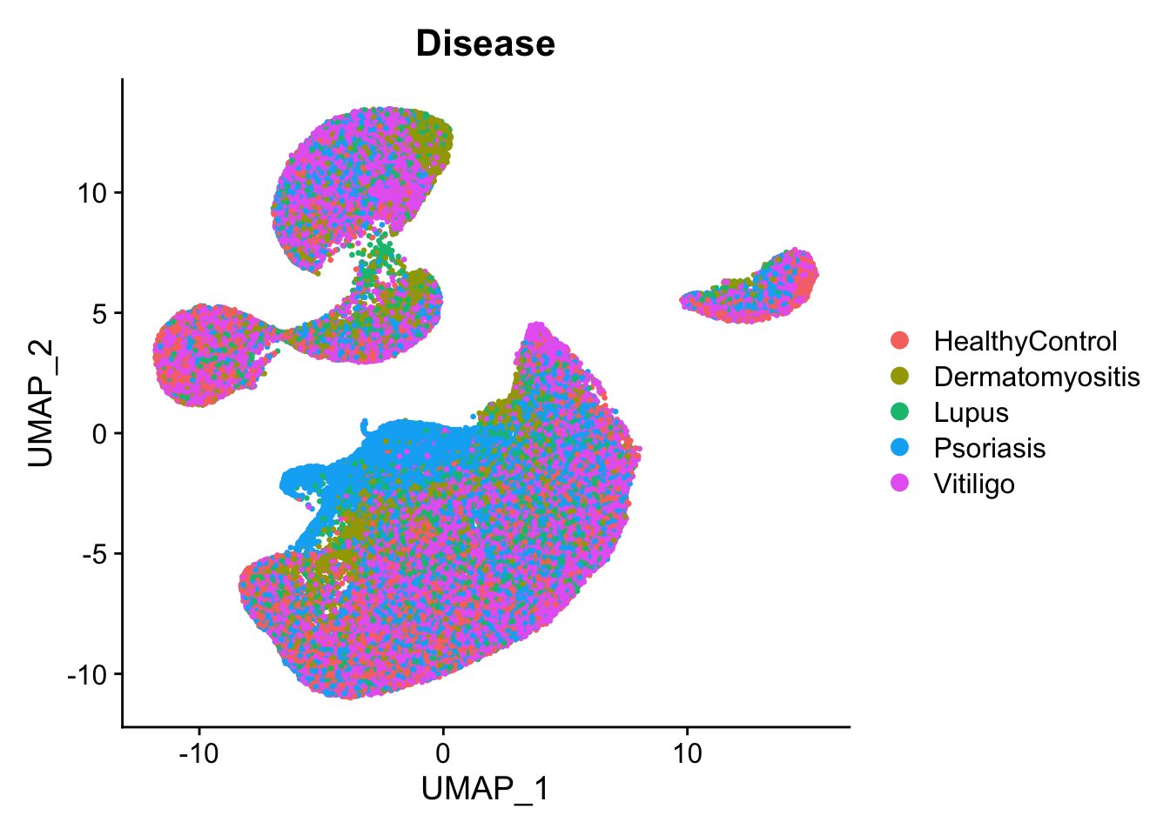
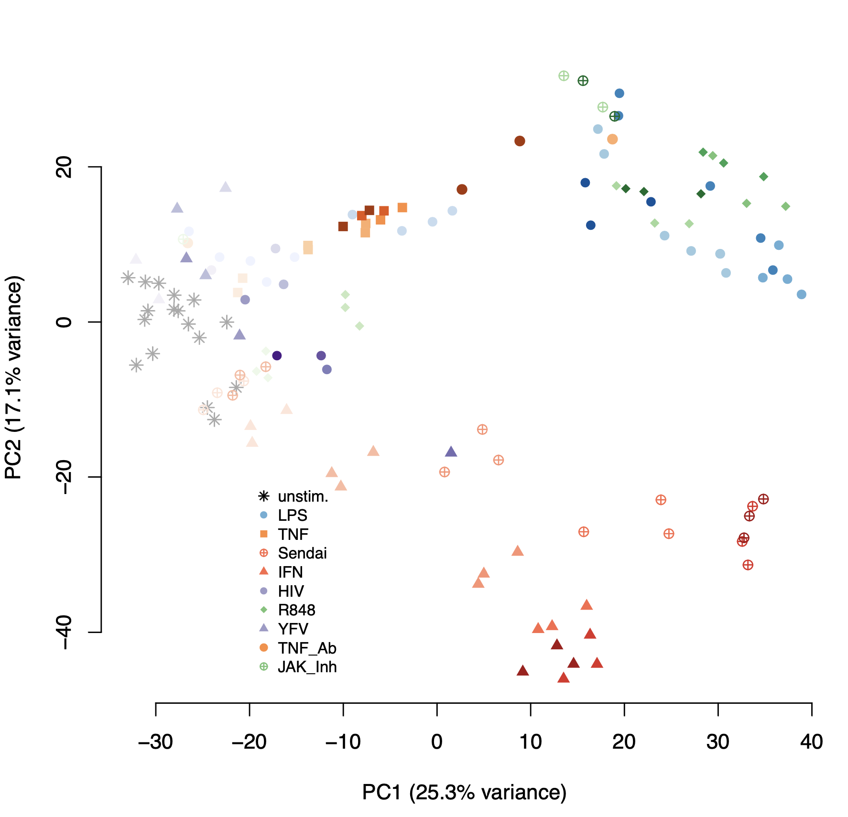
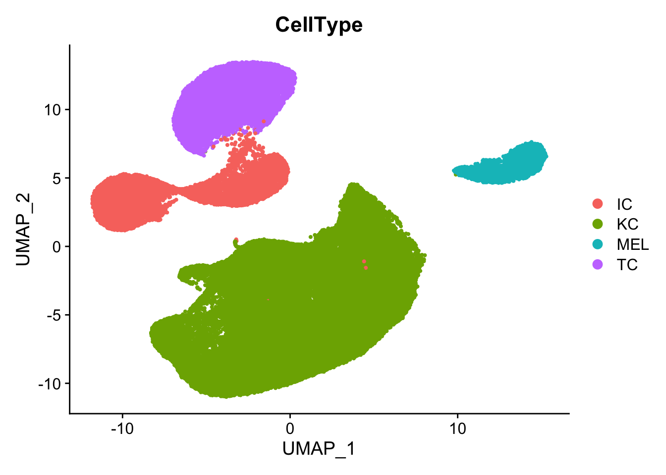
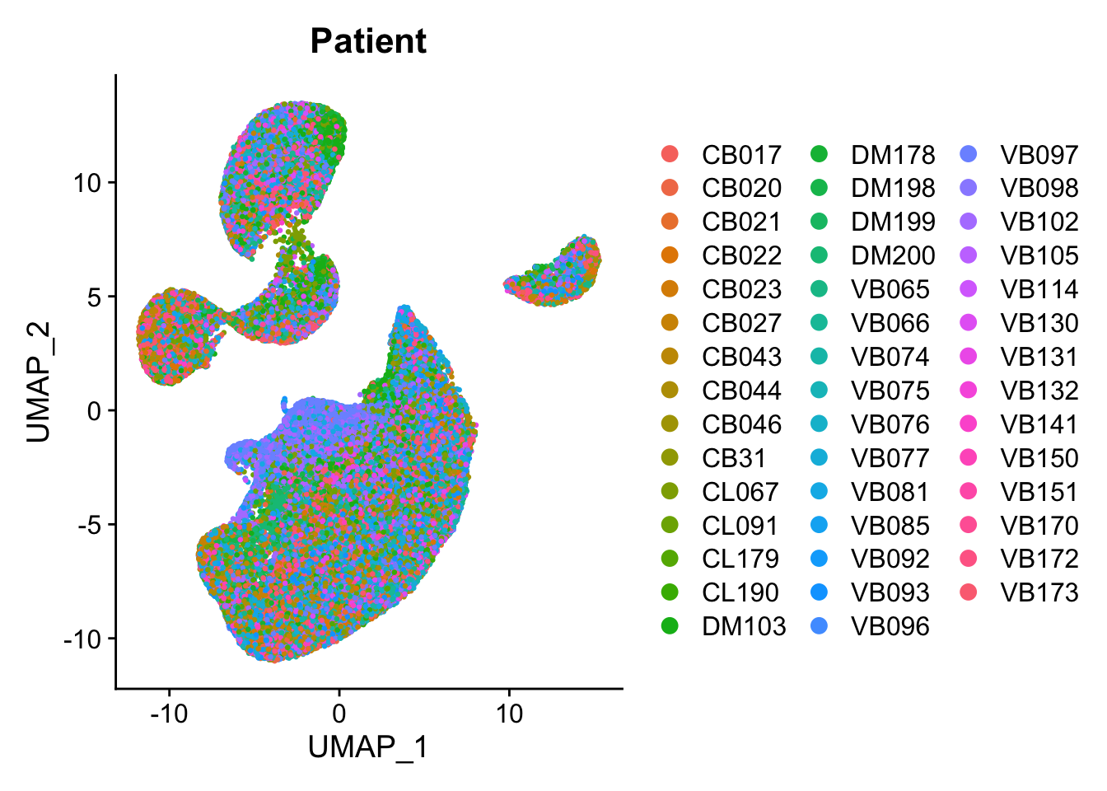
Idiosyncrasies of s.c. data

Slide 7
Idiosyncrasies of s.c. data
 | Sample | Sample | Sample | ….
Gene1
Gene1
Gene1
 | Bc_sample | Bc_sample | Bc_sample | ….
Gene1
Gene1
Gene1

Slide 8
Idiosyncrasies of s.c. data
Gene expression
Gene expression
Decorations
Cell Type
Sub Cell type
Position in embedding
Sample metadata
sample
Metadata
Condition
Batch
Time
barcode
Condition
Batch
Time

Slide 9
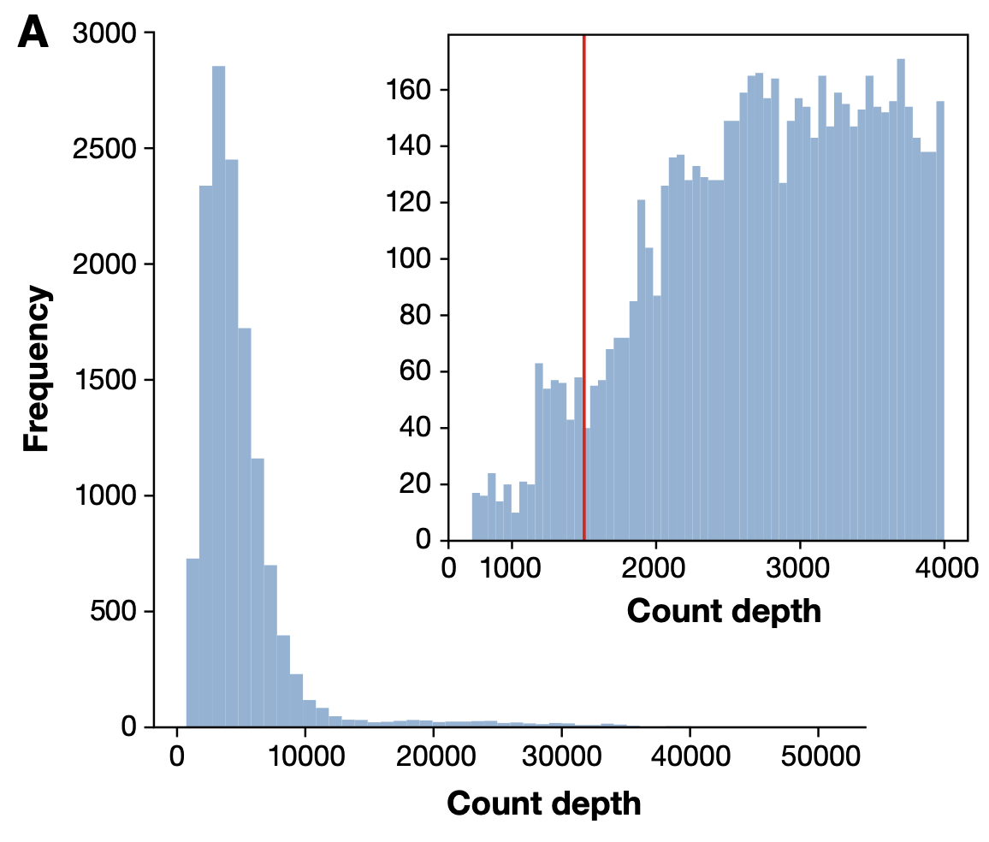
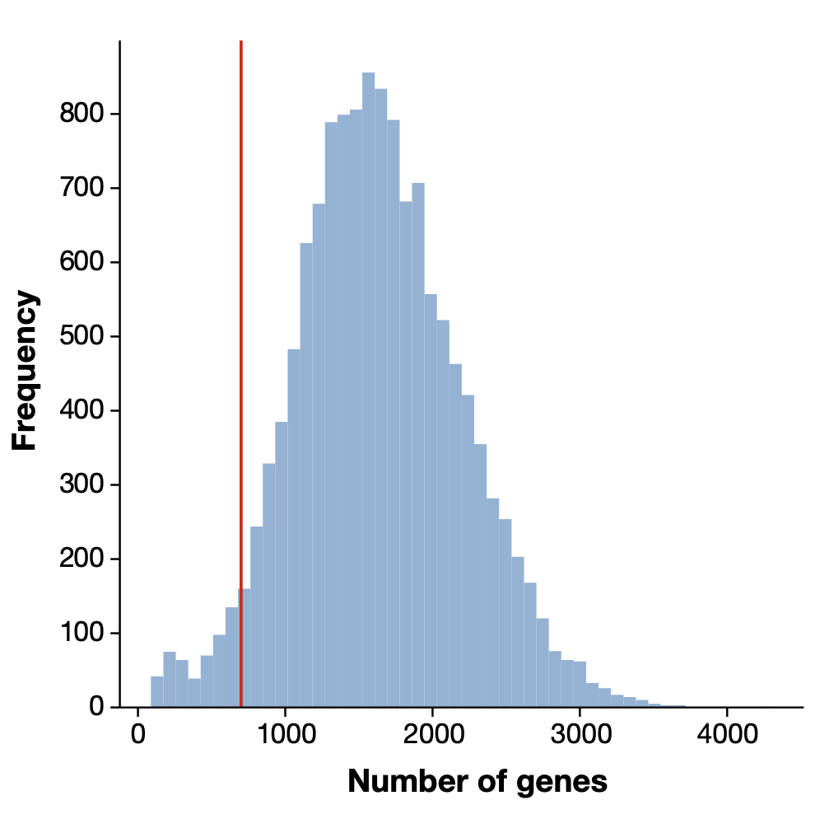
A taste of s.c. analysis -- QC
Barcodes where too few transcripts or genes are detected are likely empty droplets or noise
Luecken & Theis MSB 2019
Notes:
Cell with

Slide 10
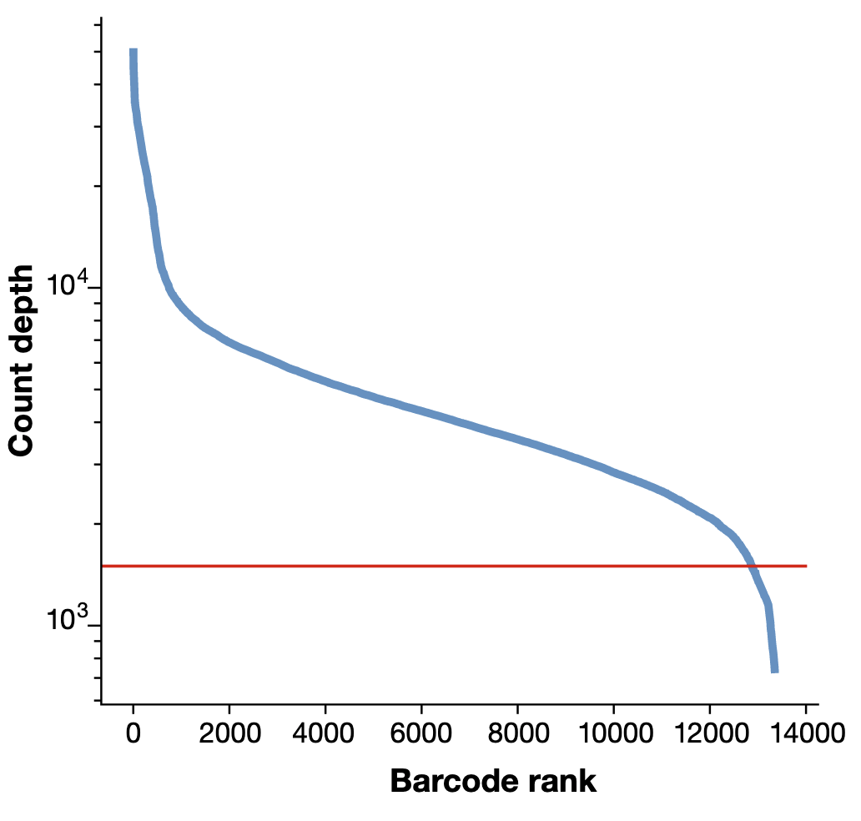
A taste of s.c. analysis -- QC
Barcodes where too few transcripts or genes are detected are likely empty droplets or noise
When data is clean the elbow method can be used.
Luecken & Theis MSB 2019
Notes:
Cell with

Slide 11
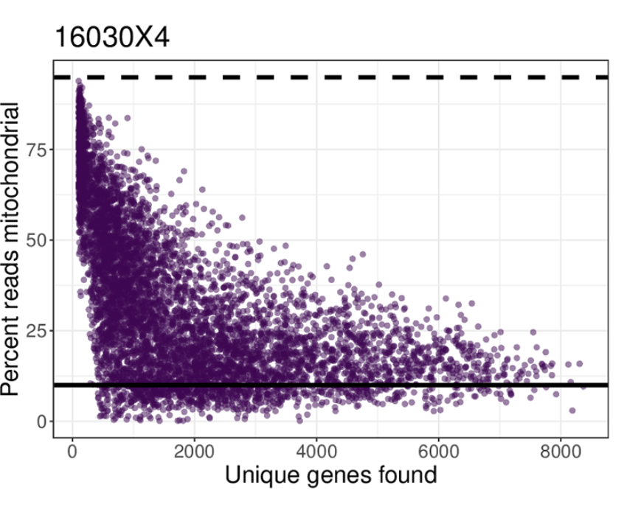
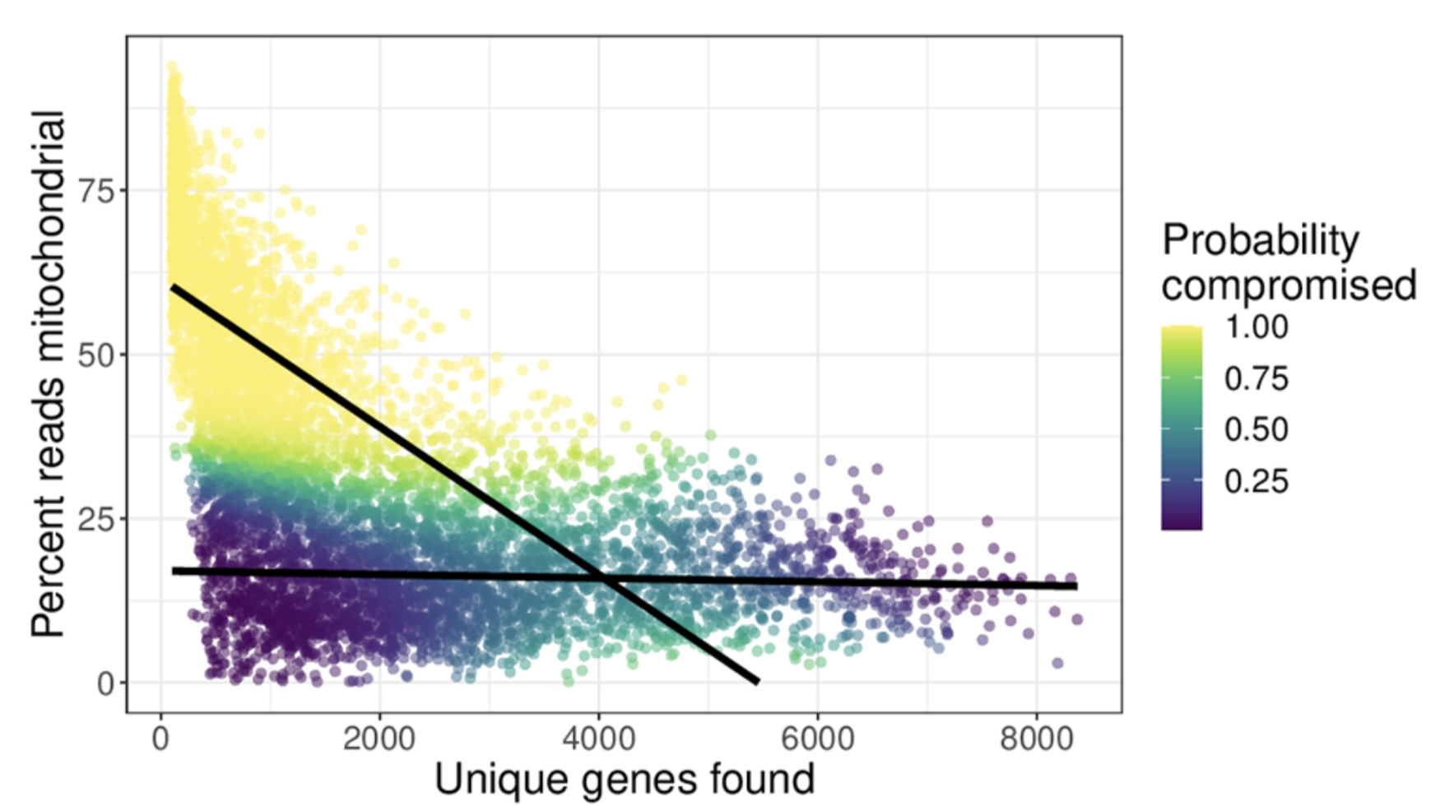
A taste of s.c. analysis – QC II
(relative) high mitochondrial counts indicates unhealthy, apoptotic cells
Hippen et. Al. PLOS Comp bio 2021
Notes:
Cell with

Slide 12
s.c. analysis – Normalization and curation
In bulk RNA-Seq normalization aimed at making genes comparable across samples by
Eliminating the impact of differences in sequencing depth between samples
Correcting global differences between conditions (TMM, scaling factors)
In scRNA-Seq normalization aims at making genes comparable across cells
Data sparsity makes it additionally challenging
For most common technologies (10x, split-seq) raw data is in UMIs
Like TPM, Counts per Millions (CPM) is the simplest normalization technique but is not optimal
The CPM of a gene has low accuracy vs TPM of a gene in a bulk sample
CPMs have inherently more variance.
Gene specific or gene group specific normalization is ideal (e.g. sctransform)
Removal or artifacts:
Empty droplets – barcodes with low transcripts
Doublets – more than one cell with the same barcode
Dying cells – High mitochondrial gene expression

Slide 13
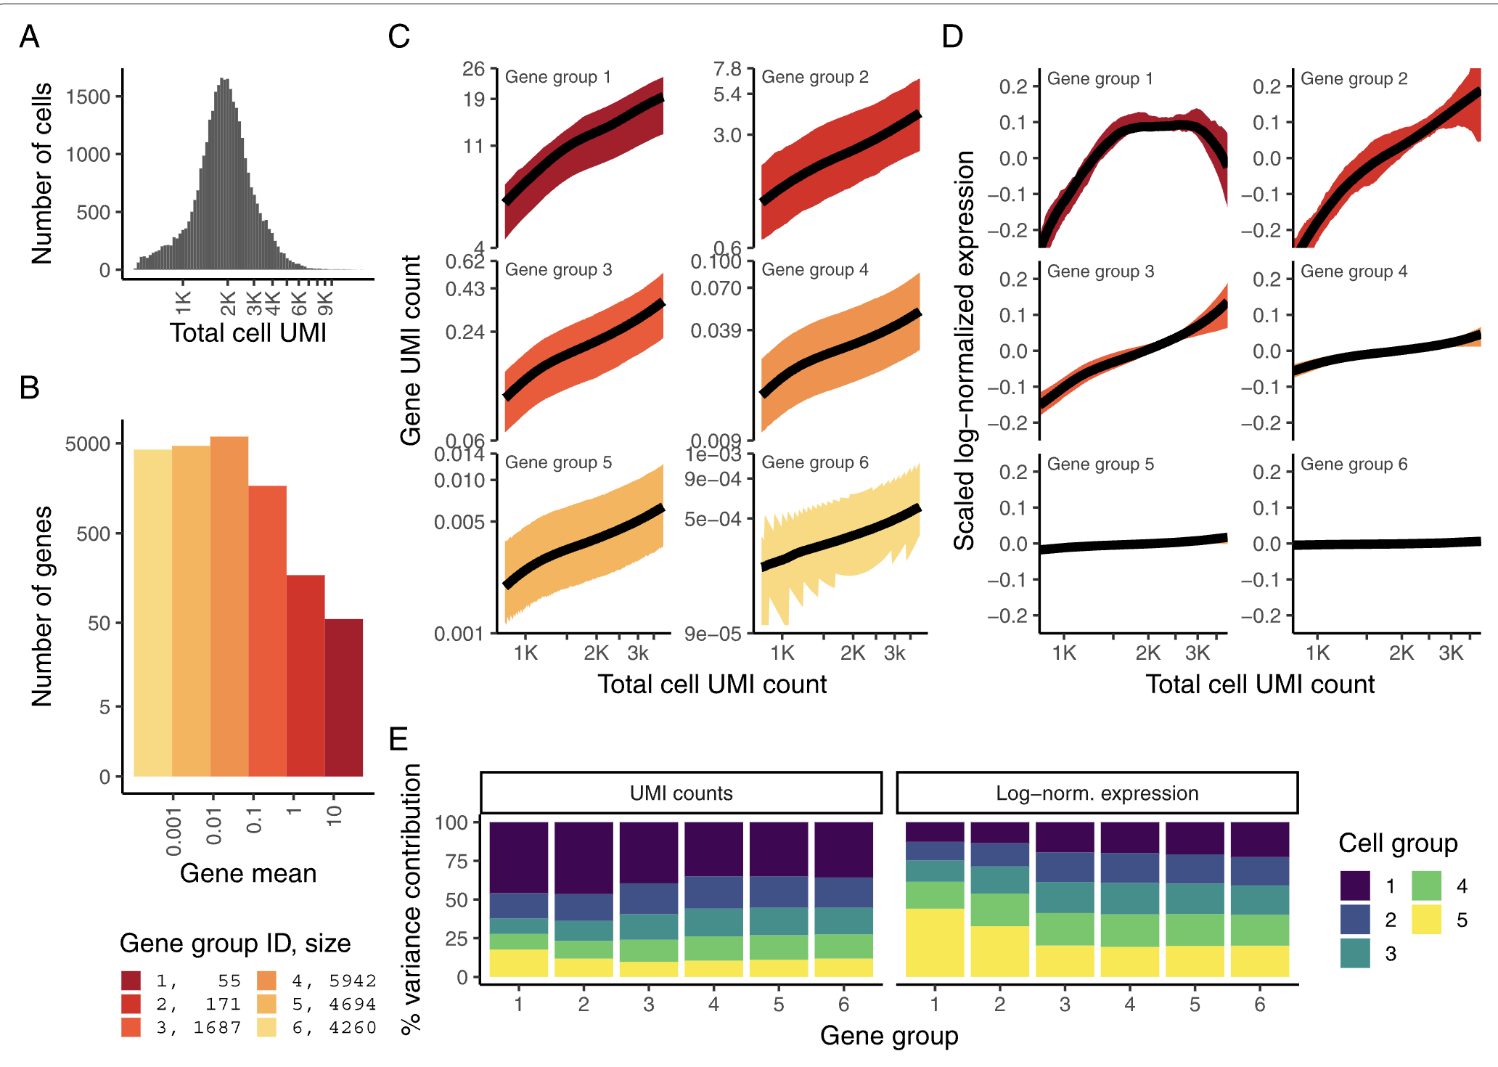
CPMs do not work well –> Variance stabilizing transformation
Hefemeister, Satija Genome Biol. 2019

Slide 14
s.c. analysis – Dimensionality reduction and clustering
Gene selection: Choose set of genes that represent biological variance.
VST has works best in our hands
Decide on a number (ad-hoc e.g., 2,000) – results are robust to this choice
First dimensionality reduction
Use linear combination of genes that capture most (relevant) of the signal in the data
Principal component analysis (PCA) is the most common. Orthogonal linear combinations that capture variance in the data
Independent component analysis (ICA) was initially widely used. Linear combinations are found such that they are maximally independent.
The number of components can affect following steps. Current PCA based methods weigh linear combinations by the variance explained.
Between 10-50 dimensions is common.
Clustering to find groups of cells that have similar expression and that represent similar types or states
The number of clusters must be explored
Iterative clustering usually done to partition more similar cell types
For visualization, a second dimensionality reduction to “embed” cells into 2 dimensions (t-SNE, UMAP).

Slide 15
s.c. analysis – Marker selection and cell type identification
Compare clusters to identify genes that are “highly differential” and that represent cell type identity
Use this markers together with “prior” knowledge to label clusters
Iterative clustering is commonly used to break up large cell types (e.g., Lymphocytes) into subtypes (e.g., CD8+, CD4+ NK, GD).
Analysis of initial clusters can reveal
strong batch effects
Barcodes that represent “doublet” cells

Slide 16
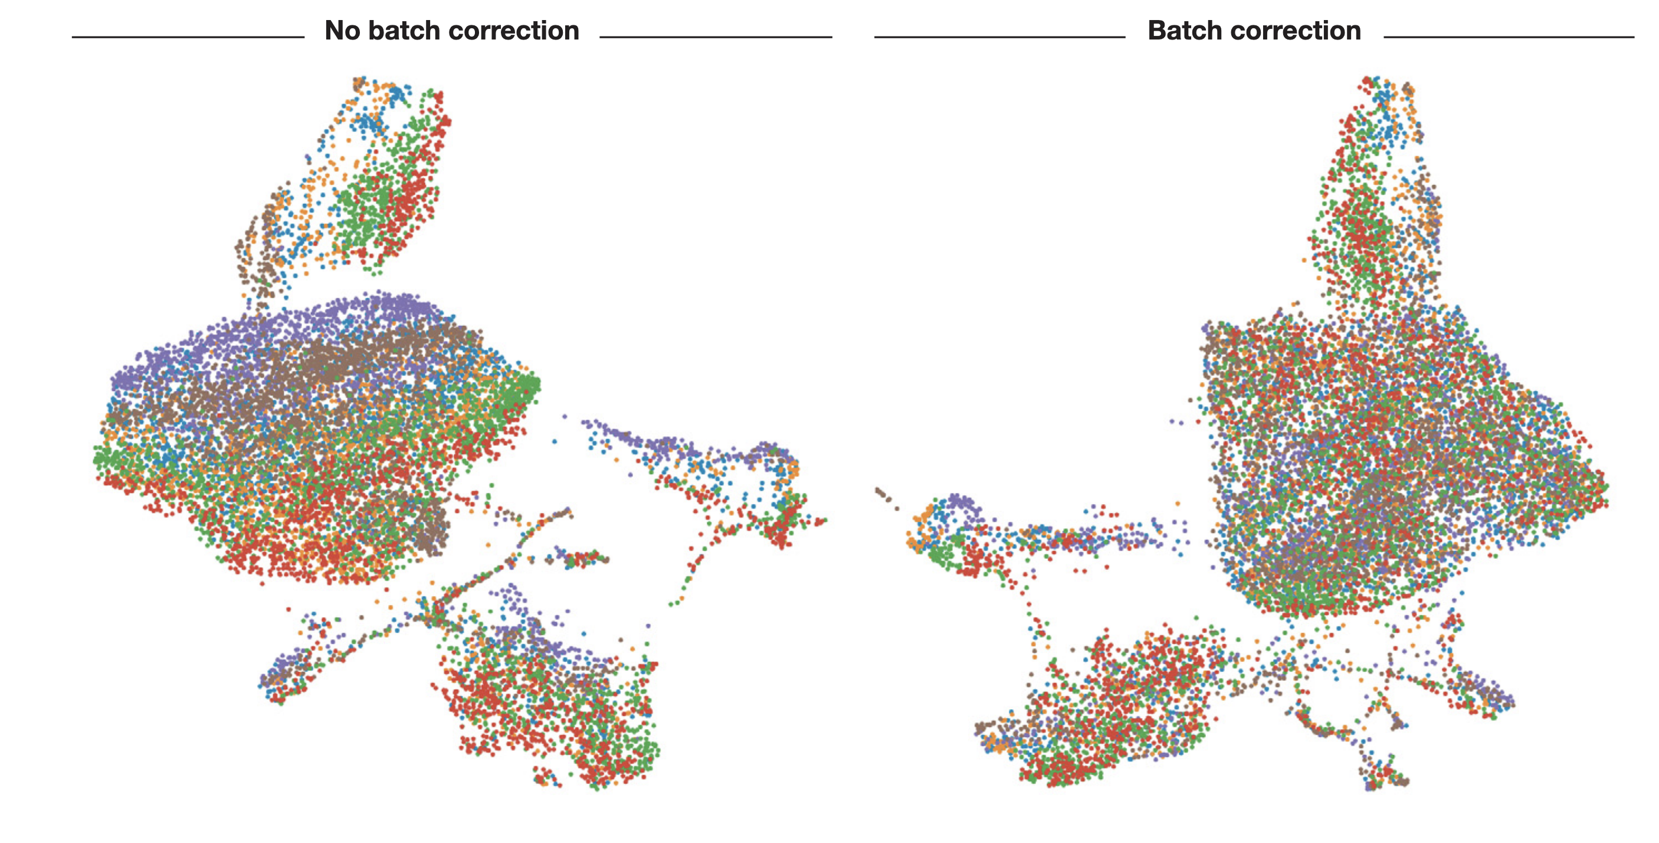
Detecting Correcting batch effects
Different colors represent different samples
COMBAT or Seurat integration functions are most effective in our hands

Slide 17
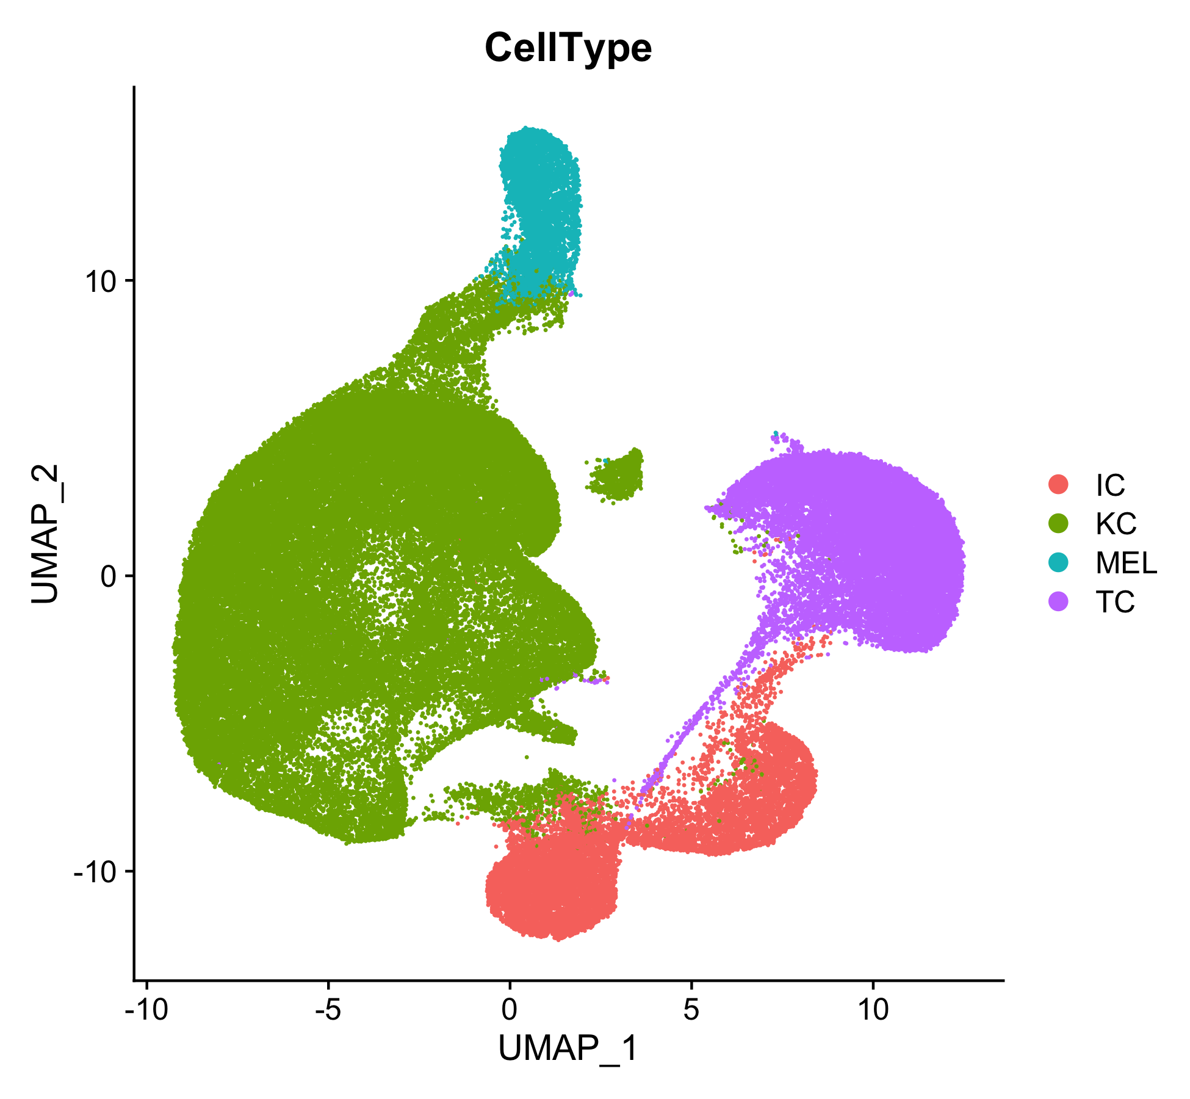
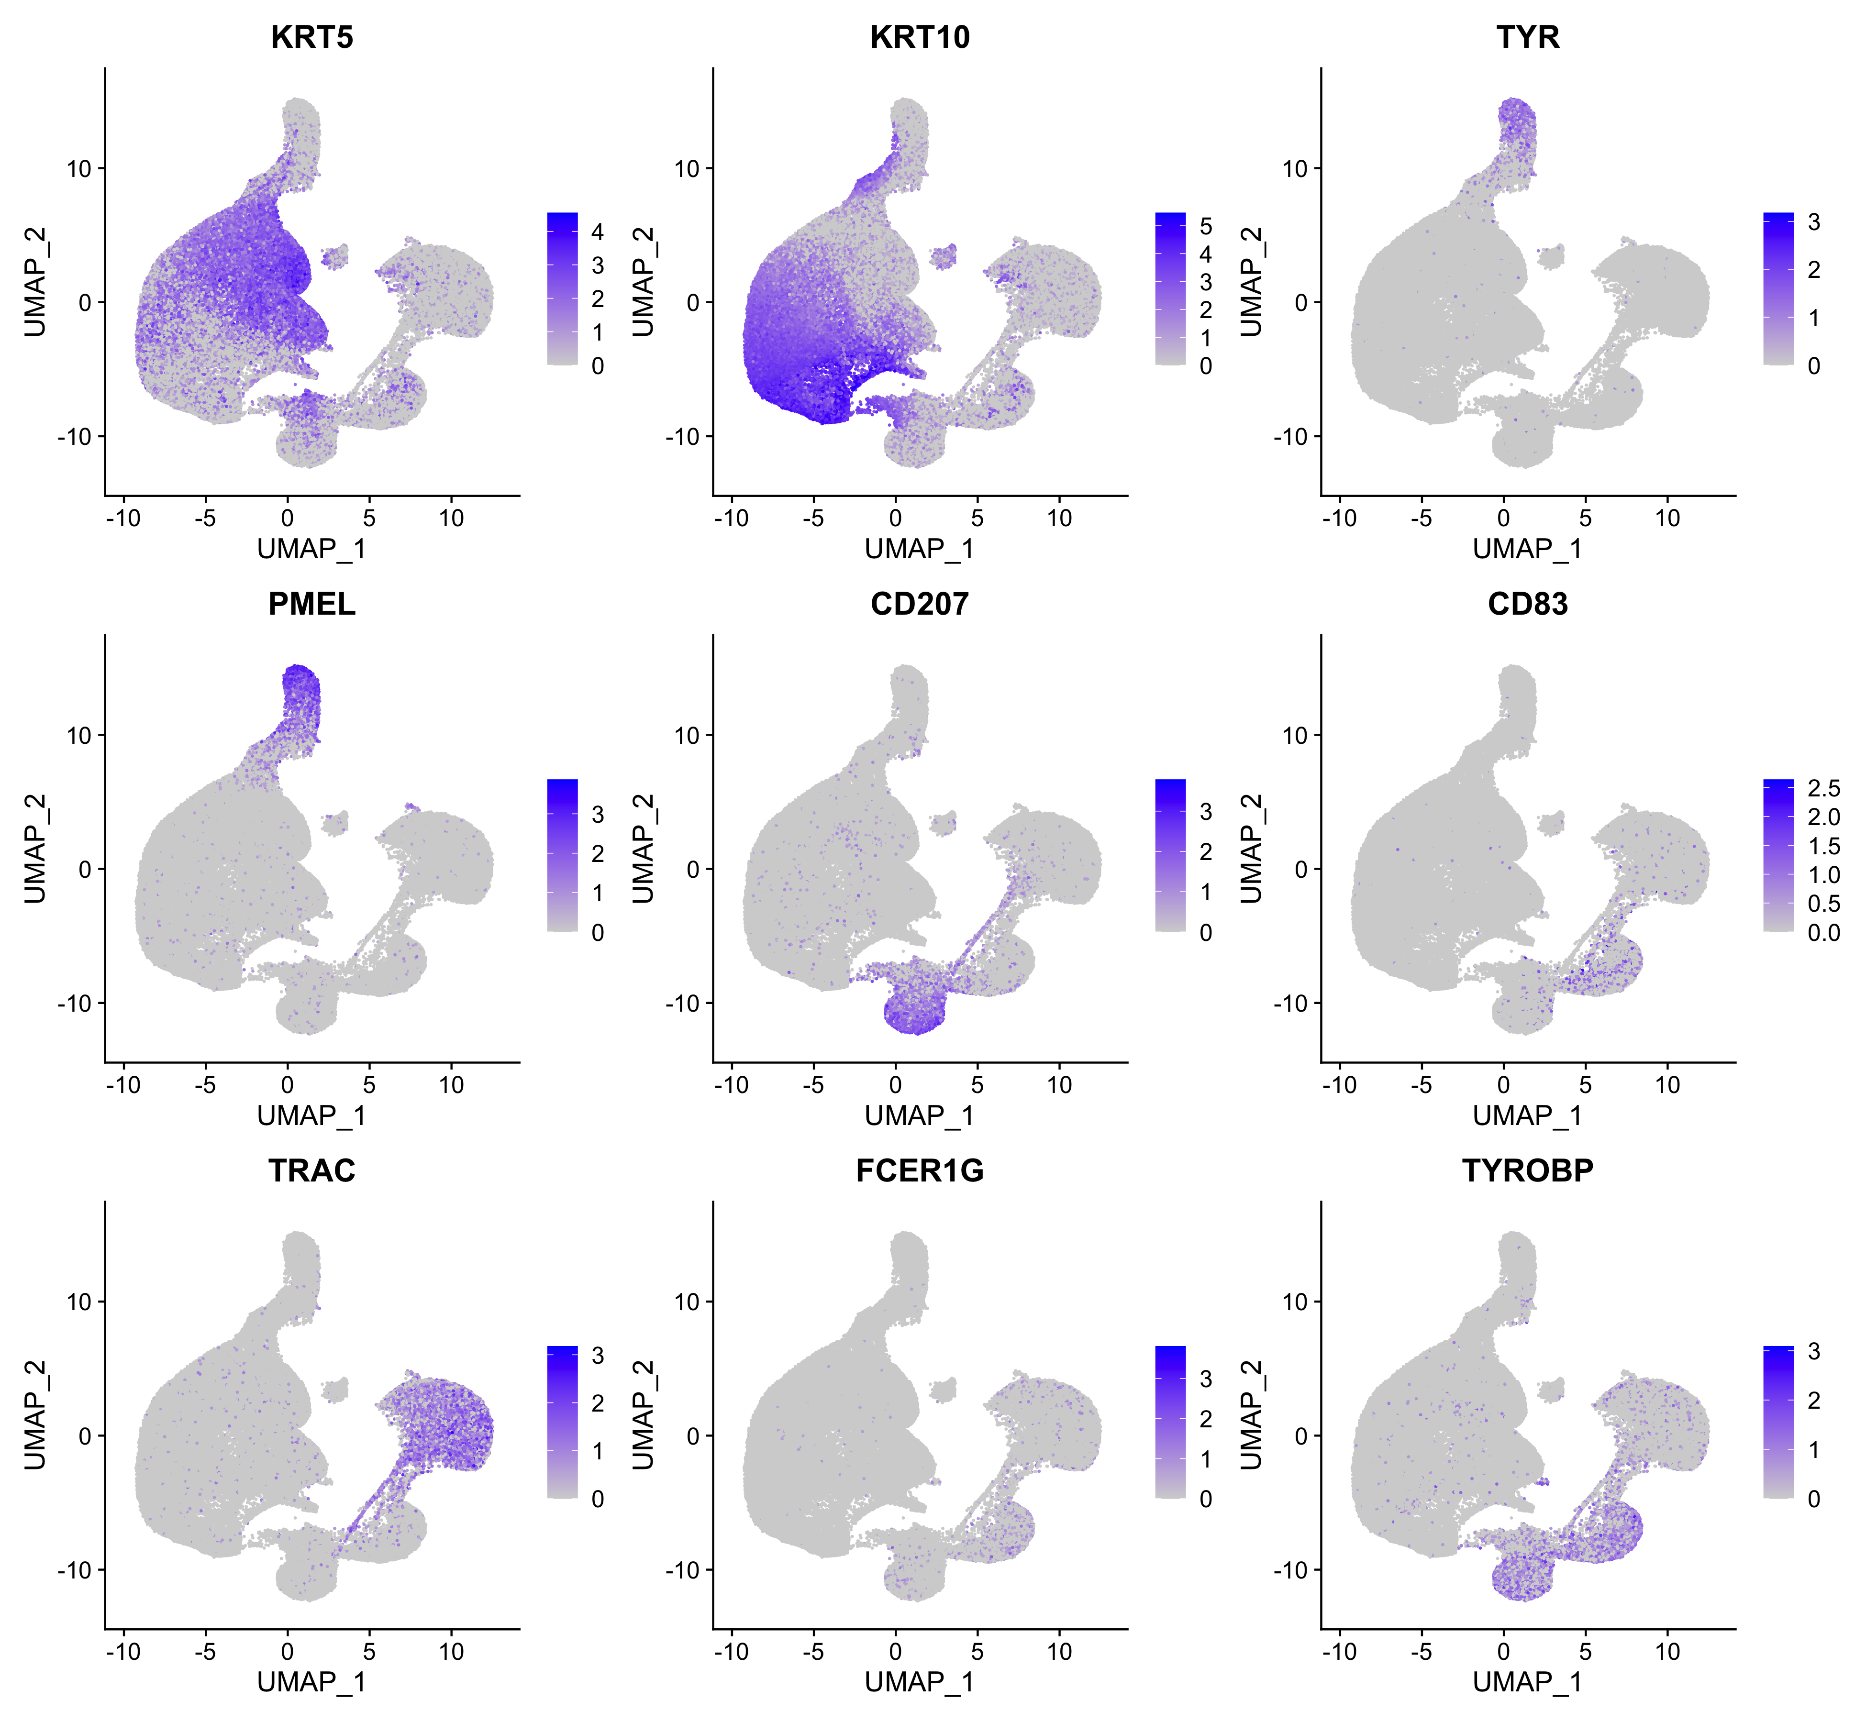
Detecting doublets
Yuqing Wang

Slide 18
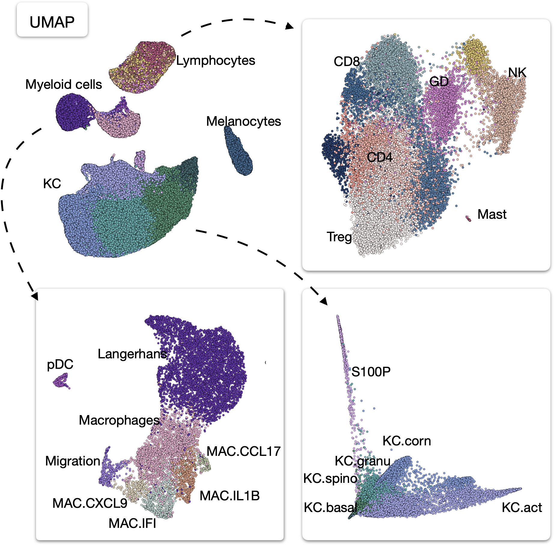
Iterative clustering to dissect cell subtypes

Slide 19
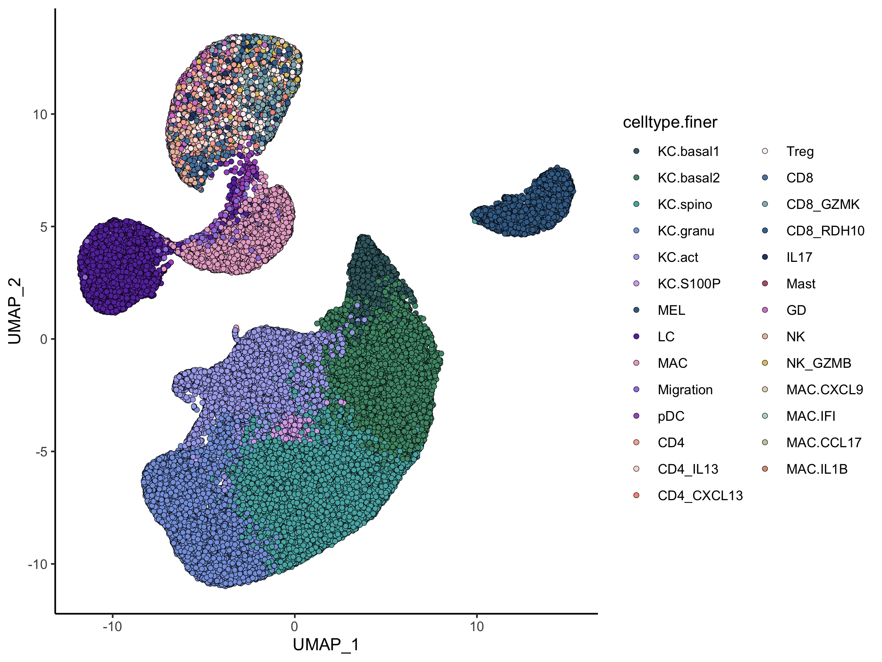
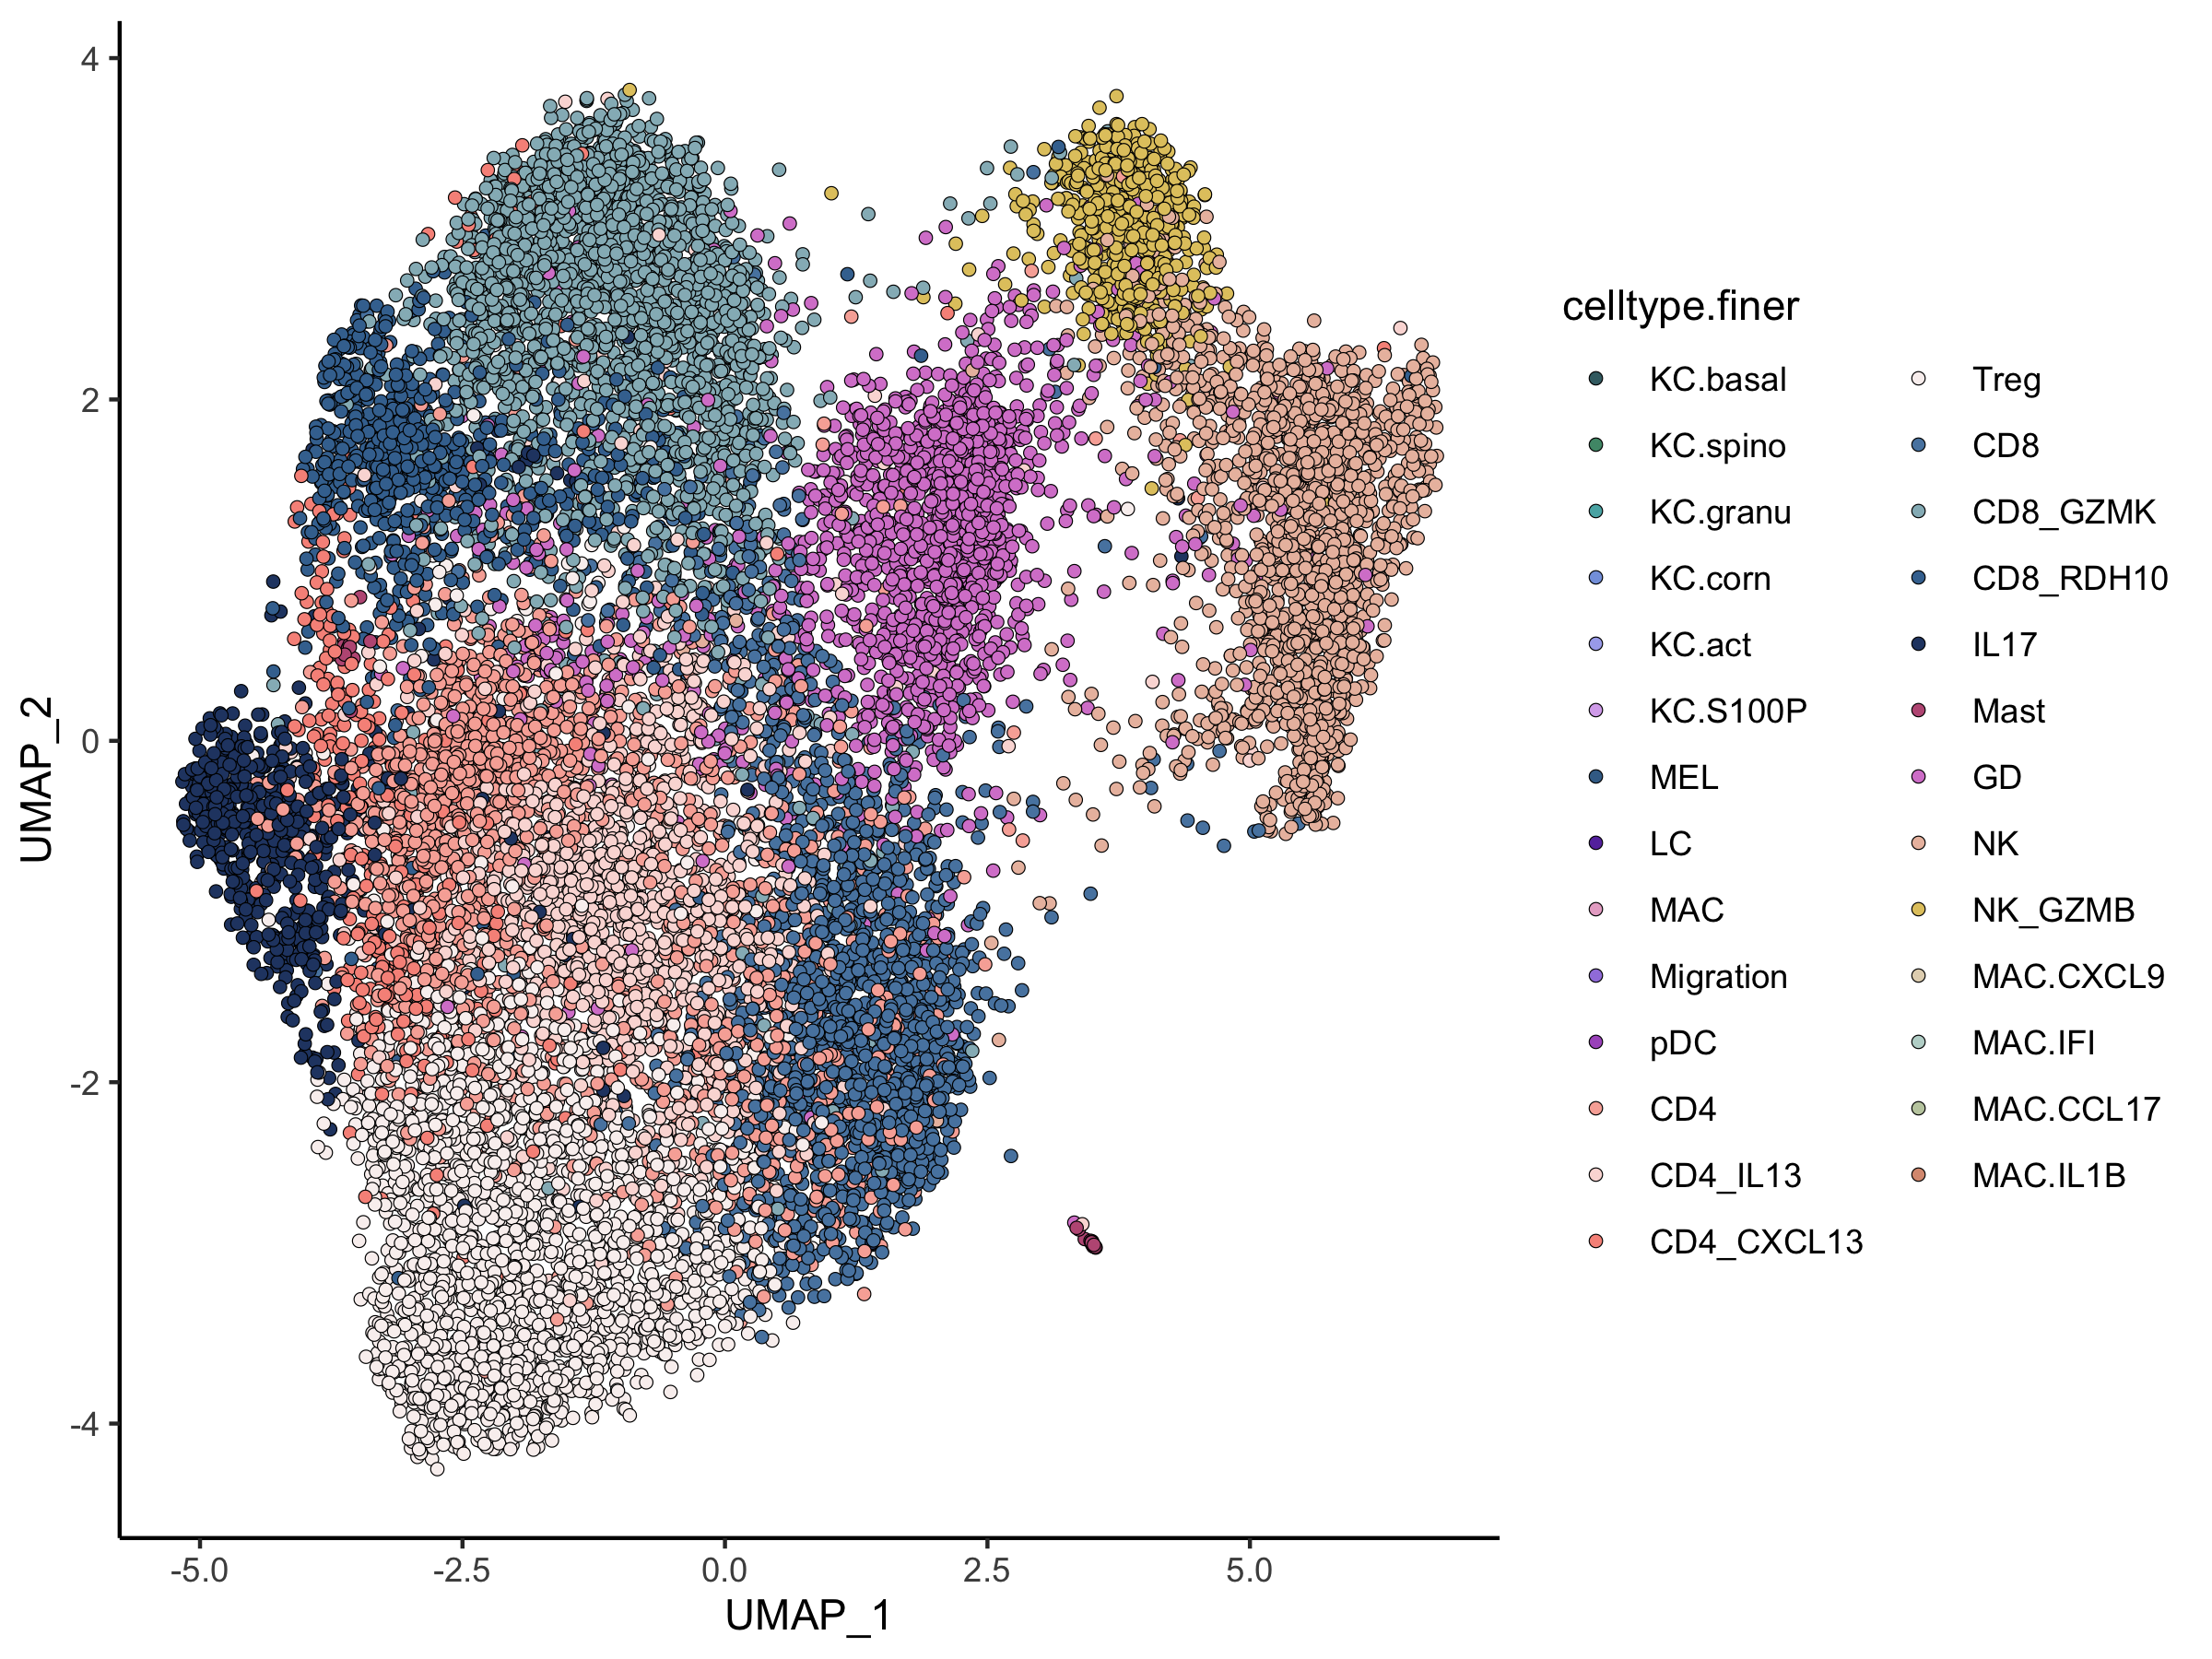
Iterative clustering to dissect cell subtypes
NK_GZMB
Lymphopcytes
CD8_GZMK
Melanocytes
GD
NK
CD8_RDH10
CD4_CXCL13
Antigen presenting
CD4_IL13
CD8_IL17
CD4
CD8
Mast
Keratinocytes
Treg

Slide 20
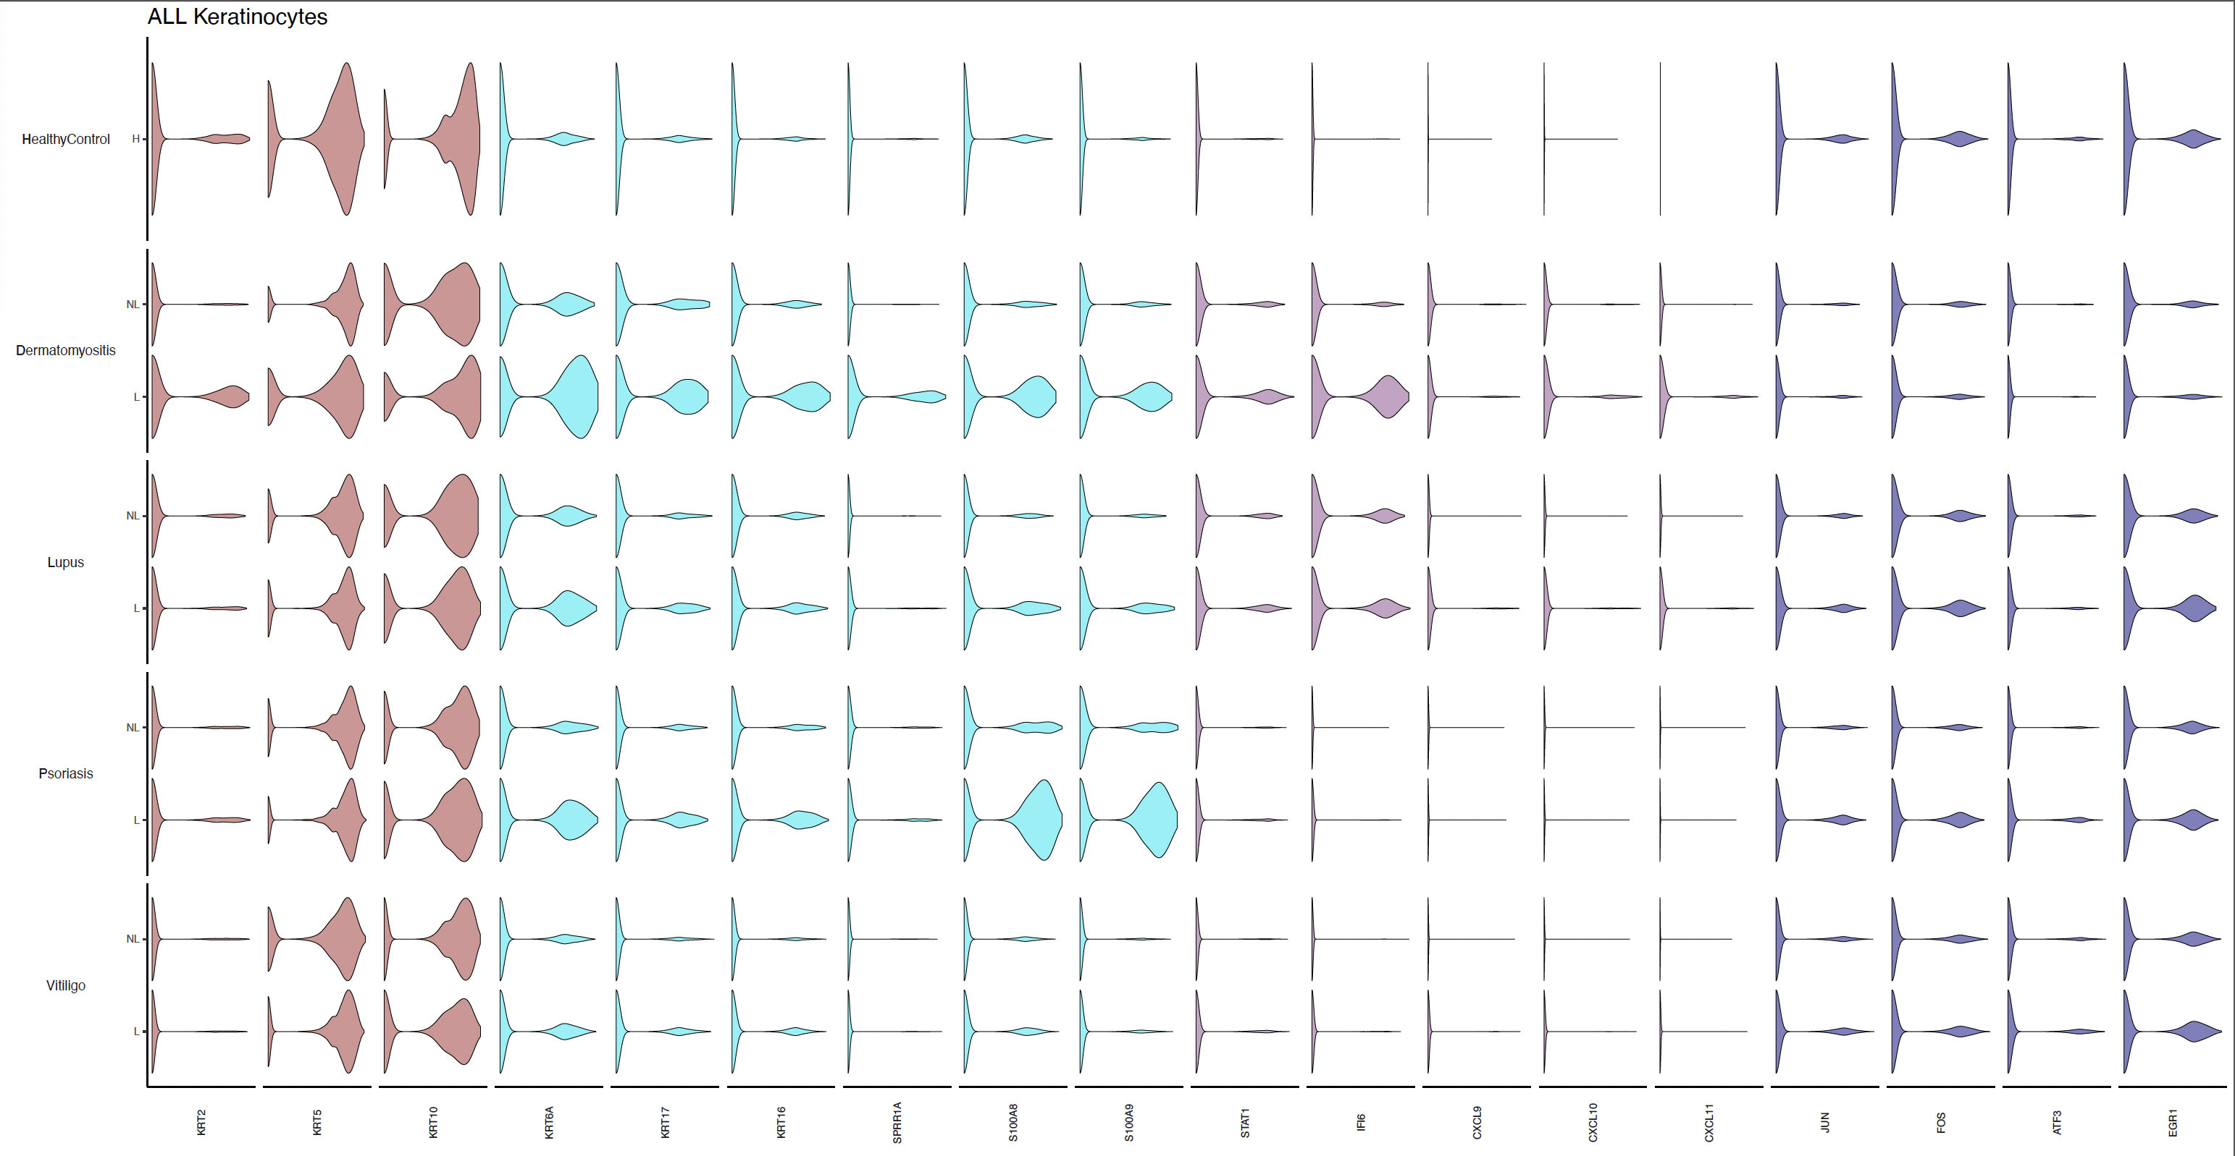
Visualizing your data – for marker genes and DE genes

Slide 21
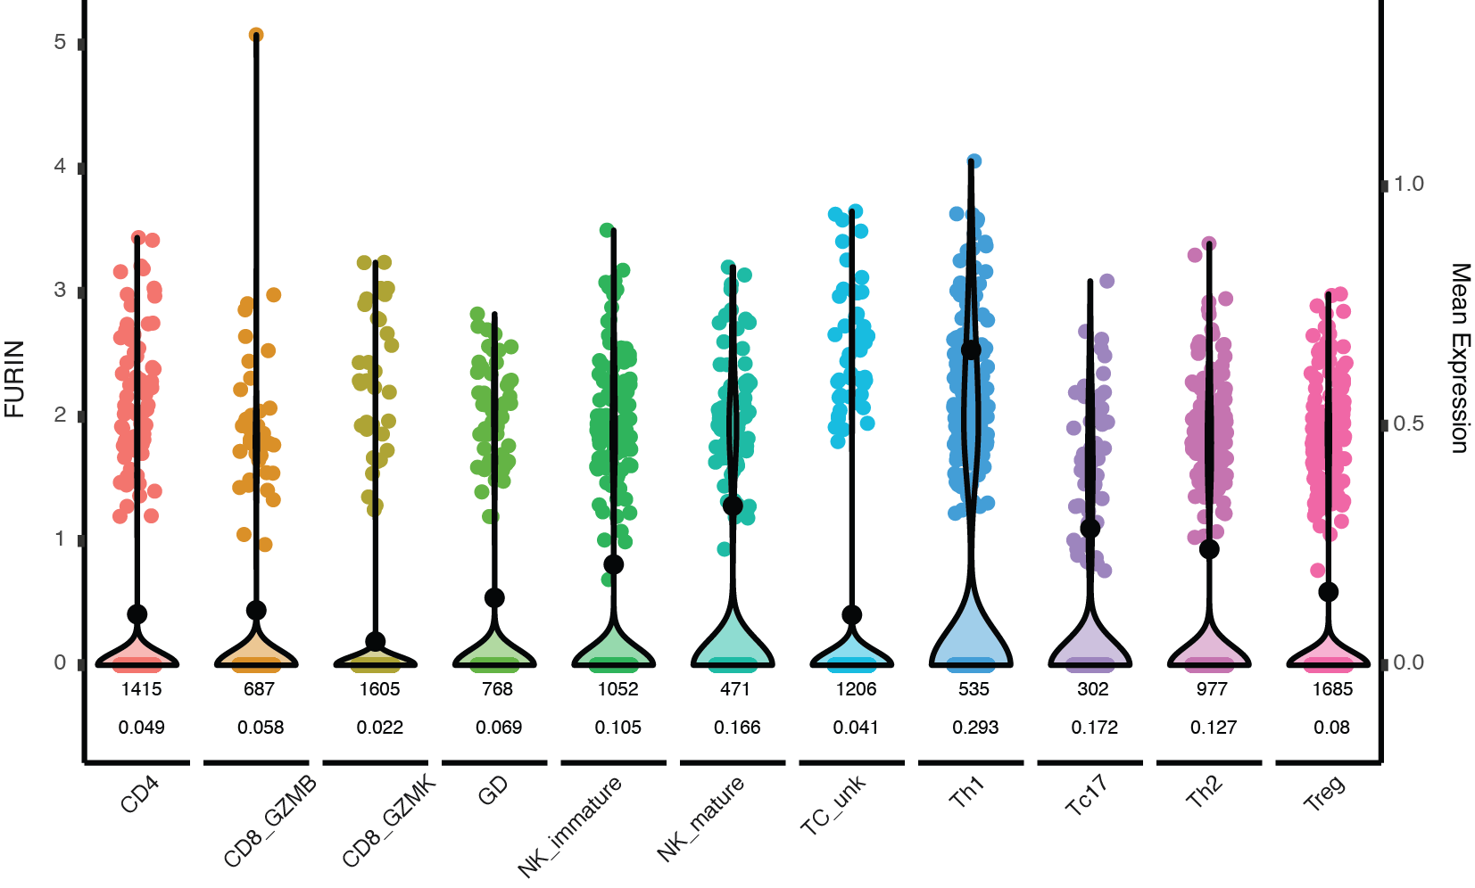
Visualizing your data – Or the detailed violin plot for a one gene

Slide 22
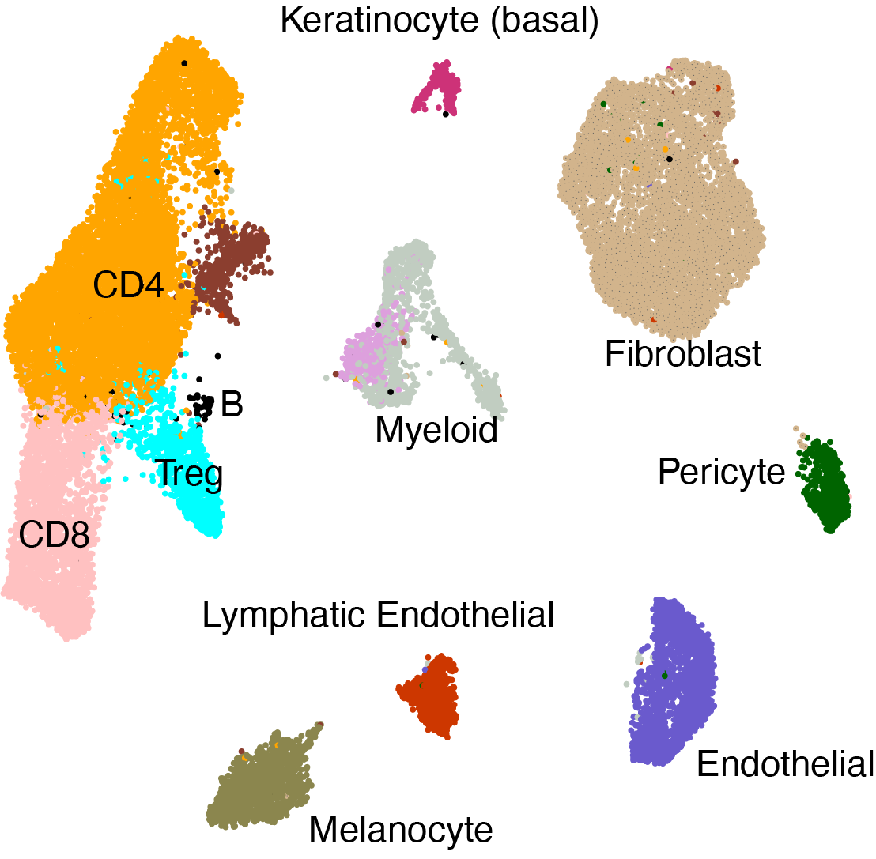
Or convert data into pseudo-bulk
Three different donors, 6 stimuli

Slide 23
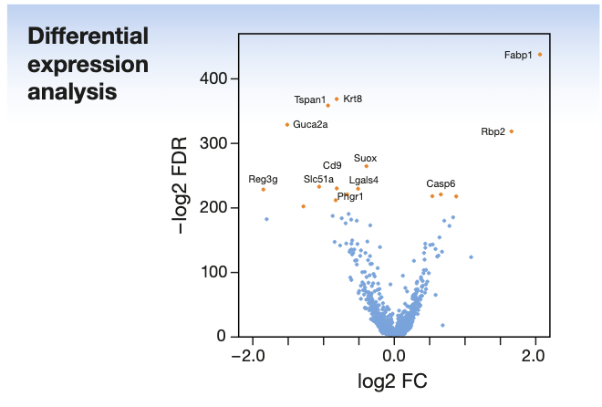
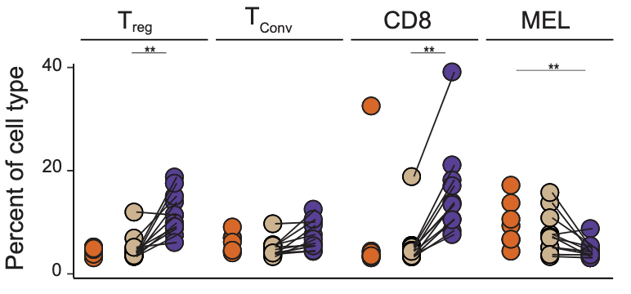
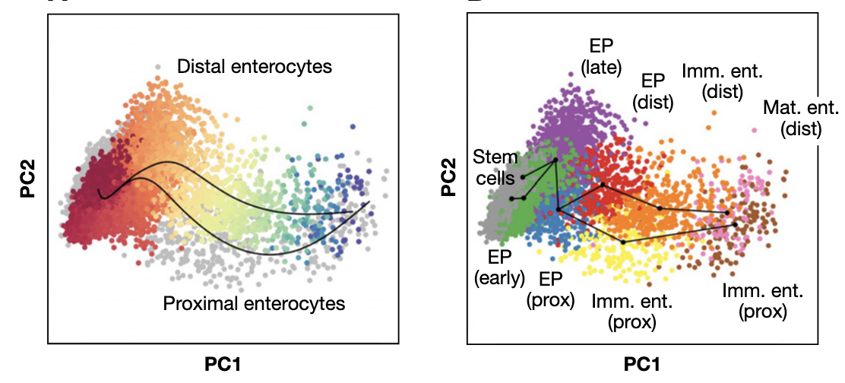
s.c. analysis – Typical analysis
Differential expression between clusters/cell types
Cell composition analysis
Trajectory analysis

Slide 24
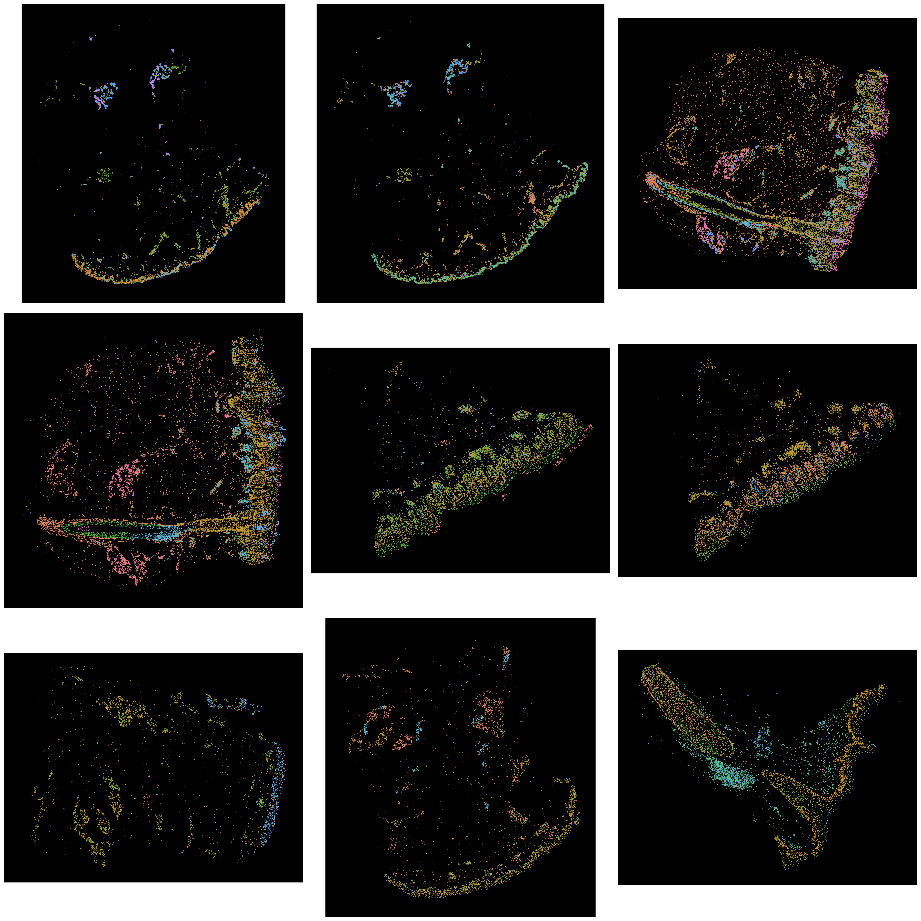
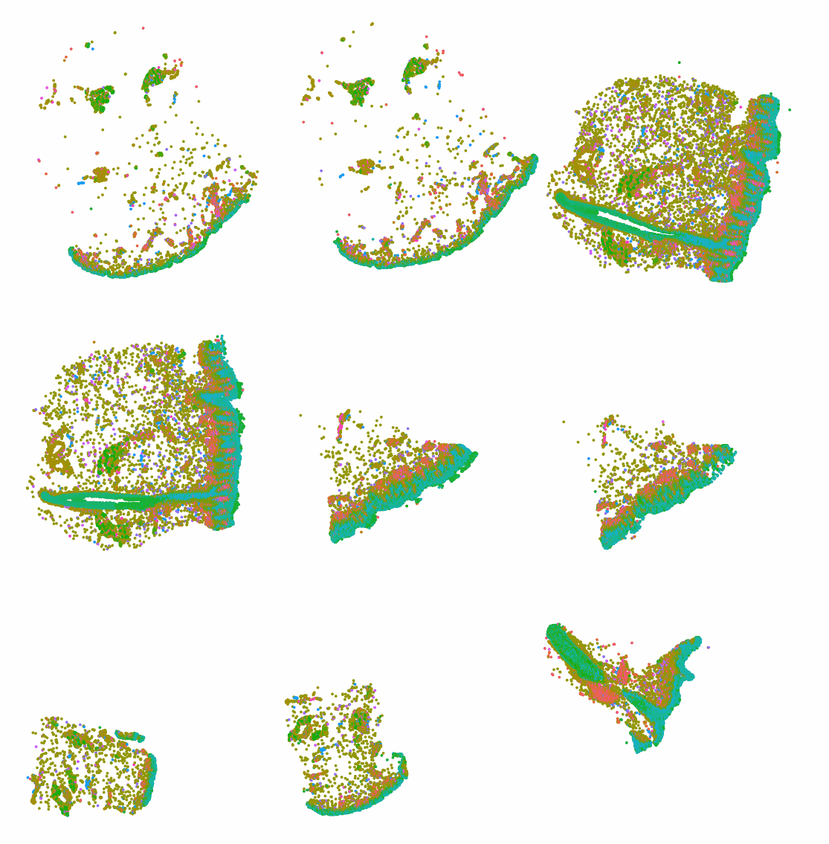
Spatial single cell omics builds on regular single cell analysis

Slide 25
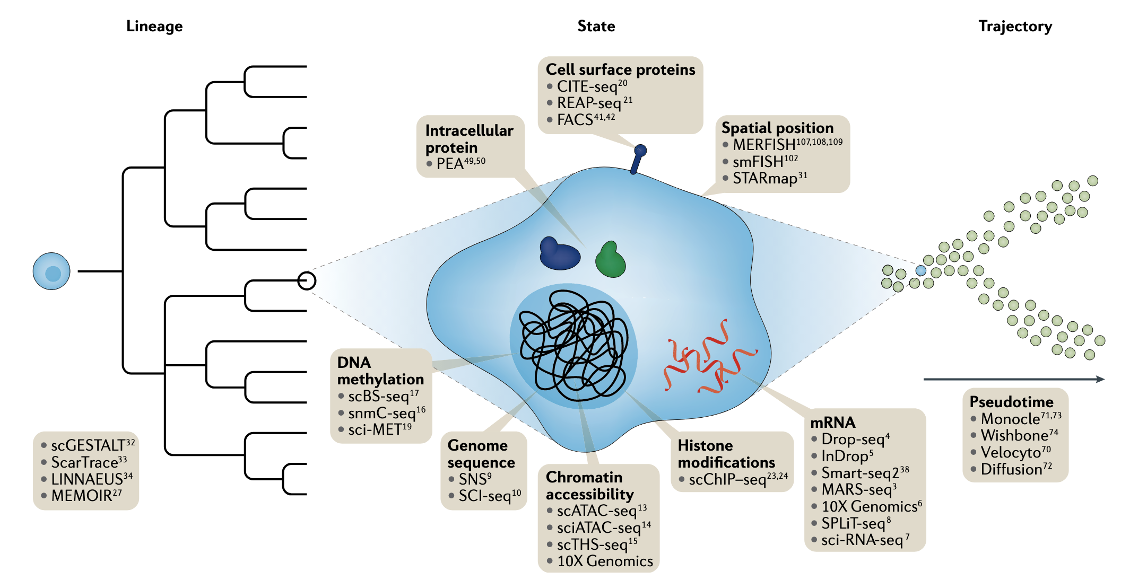
s.c. its not just RNA
Stuart & Satija NRG 2019

